Slide 1
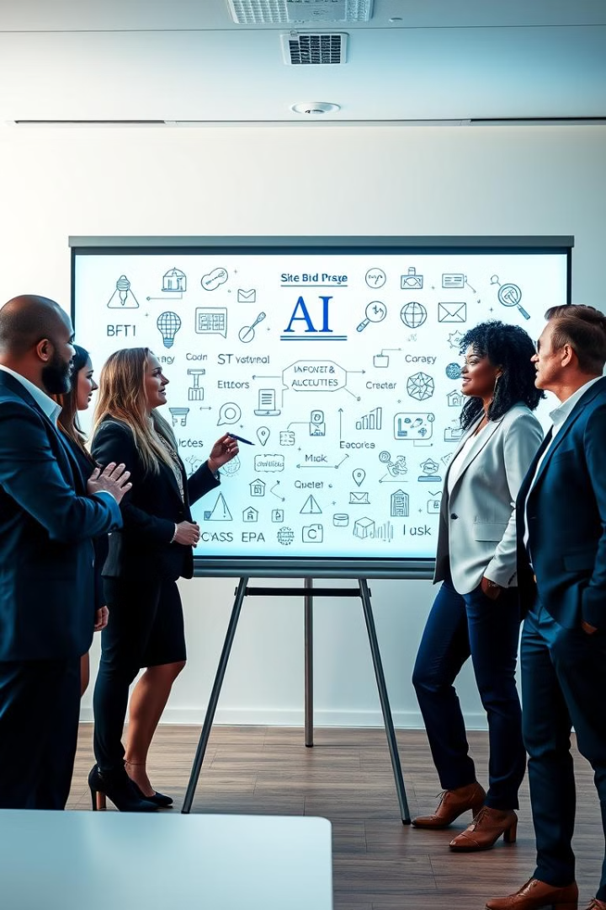

Driving AI Initiatives: The Role of Executives
Leading AI initiatives requires more than just understanding technology. It's about fostering a culture of innovation, aligning AI with business objectives, and building a skilled workforce capable of harnessing its potential.
by Akshay Damodar

Slide 2
Understanding the Transformative Potential of AI
Enhanced Efficiency
Personalized Customer Experiences
Data-Driven Insights
AI automates tasks, reduces errors, and improves productivity.
AI analyzes vast amounts of data to uncover hidden patterns and actionable insights.
AI enables personalized interactions, tailored recommendations, and increased customer satisfaction.

Slide 3

Establishing an AI-First Mindset and Culture
Embrace Change
Encourage Experimentation
Foster a culture of continuous learning and adaptability to new technologies.
Promote a risk-taking environment where employees are encouraged to explore new AI applications.
Prioritize Collaboration
Build a collaborative ecosystem where cross-functional teams can work together on AI projects.

Slide 4




Aligning AI with Strategic Business Objectives
Identify Key Areas
Define Measurable Goals
Prioritize Projects
Determine which business processes and functions can benefit most from AI.
Set specific, measurable, achievable, relevant, and time-bound objectives for AI initiatives.
Focus on AI projects that deliver the highest value and return on investment.

Slide 5




Building an AI-Ready Data Infrastructure
Data Governance
Cloud Integration
Establish clear data ownership, access controls, and quality standards.
Leverage cloud platforms for scalable data storage, processing, and AI model training.
Data Security
Implement robust security measures to protect sensitive data and ensure compliance with regulations.

Slide 6

Upskilling Employees for the AI-Augmented Workforce
1
Identify Skill Gaps
Assess the current workforce's AI skills and knowledge.
2
Develop Training Programs
Offer hands-on training, workshops, and certifications in AI fundamentals, tools, and applications.
3
Mentorship and Support
Provide ongoing mentorship and support to employees transitioning to AI-driven roles.

Slide 7
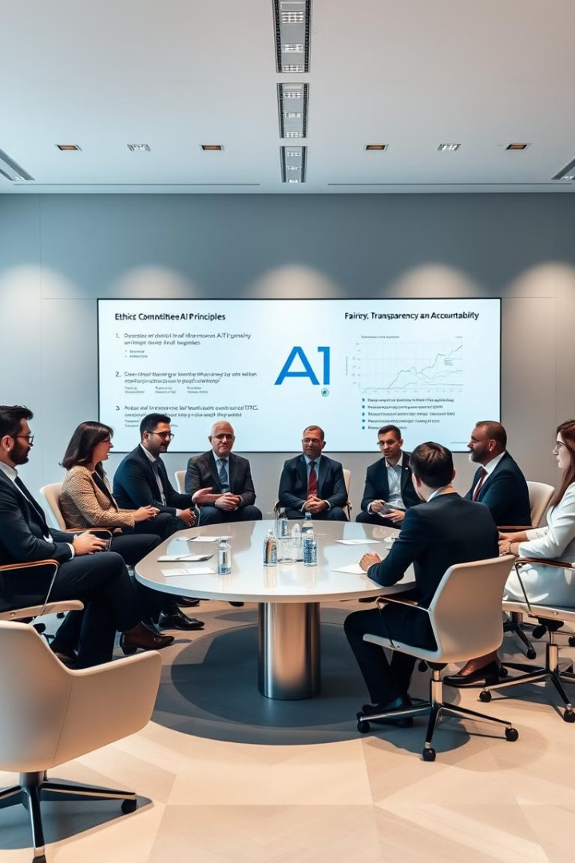
Ensuring Responsible and Ethical AI Governance
Bias Mitigation
Transparency and Explainability
Develop strategies to identify and address biases in AI algorithms and data sets.
Ensure AI decisions are transparent and explainable to stakeholders.
Data Privacy and Security
Implement strong data privacy and security protocols to protect sensitive information.

Slide 8

Fostering a Collaborative Ecosystem for AI Innovation
1
2
3
Partnerships
Open Innovation
Hackathons and Competitions
Collaborate with universities, research institutions, and technology companies to access cutting-edge AI expertise.
Engage in open-source AI projects and participate in AI communities.
Host hackathons and competitions to foster innovation and attract top AI talent.

Slide 9
Measuring and Optimizing the ROI of AI Investments
Track Key Metrics
1
Measure AI-related metrics such as efficiency gains, customer satisfaction, and revenue growth.
Analyze Performance
2
Regularly analyze AI project performance and identify areas for improvement.
Optimize and Adapt
3
Continuously refine AI models, processes, and workflows to maximize ROI.

Slide 10

Embracing Adaptability and Continuous Learning
AI is a rapidly evolving field. Executives need to stay informed about the latest trends and advancements in AI. Continuous learning and adaptability are essential for staying ahead of the curve.

